Slide 1
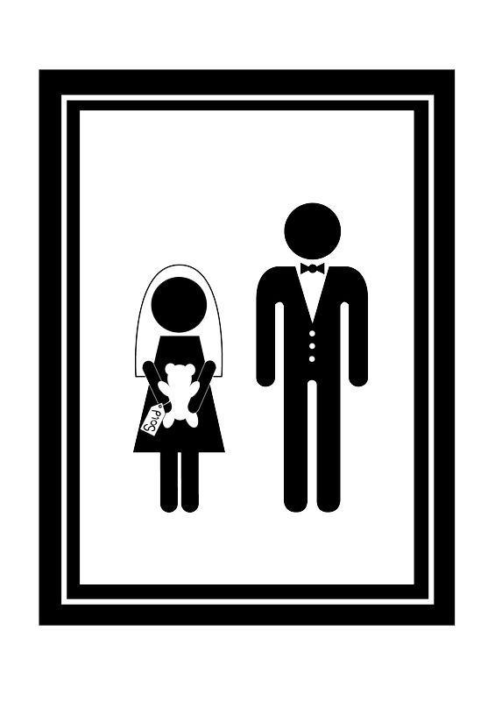
CHILD MARRIAGE IS NOT A MINOR PROBLEM

Slide 2
Why child marriage is major issue?

Slide 3
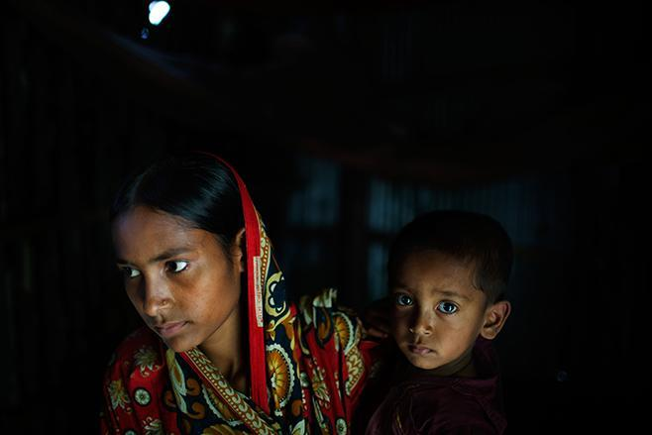
One Example.
Belkis, 15 years old, holds her one-year-old son in her mother’s house which she returned to after the husband she was married to at age 13 abandoned her. She fears her family’s home will be washed away by river erosion by the end of the year.
© 2015 Omi for Human Rights Watch

Slide 4
Testimonials
“Now she is pretty and young and we can give her away for free. If you bring the police we will have more problems when she gets older.” –Ruhana M.’s older brother, arguing for why Ruhana should marry at age 12, after her uncle threatened to prevent the marriage. The marriage went forward.
“I got married and I quit school.” –Mariam A., who married at age 15. She left school after class 5 because going on to class 6 would have involved higher costs and a longer walk of 3.5 kilometers each way.
“This is a place affected by river erosion,” Azima B.’s parents told her, explaining why she had to marry at age 13. “If the river takes our house it will be hard for you to get married so it’s better if you get married now.”

Slide 5
Countries with highest % in Child Marriage Under 15 years

Slide 6
Root causes.
01
GENDER INEQUALITY
girls are seen as burden.
CULTURE AND TRADITION
because it has happened for generations.
02
03
POVERTY
marriage will be a solution to secure their future.
04
INSECURITY
Girls are seen as burden.

Slide 7
15 million
15.4 million
children are married year.
children will get married every year By 2030

Slide 8
That is approximately:
41,000 girls per day, 28 girls every minute,
1 girl every 2 second

Slide 9
Problems:
Too young to decide for themselves
School Friends/Family
Lack of free will
Psychological Effect
Violation of health rights

Slide 10
Health Effect & Psychological Effect :
Health Effect
STI’s can form
Cervical cancer
Fistulas
Infant mortality
Psychological Effect
Pressure
Emotional blackmail
Too many responsibilities

Slide 11
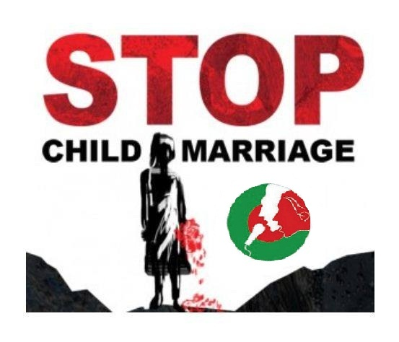
What Can BE Done?
Education Female empowerment
Strict application of law
Reduction of poverty Raising awareness especially among rural and poorest people
Change of perception and mindset
Responsibility of Government and Non-government Organization
Religious view

Slide 12
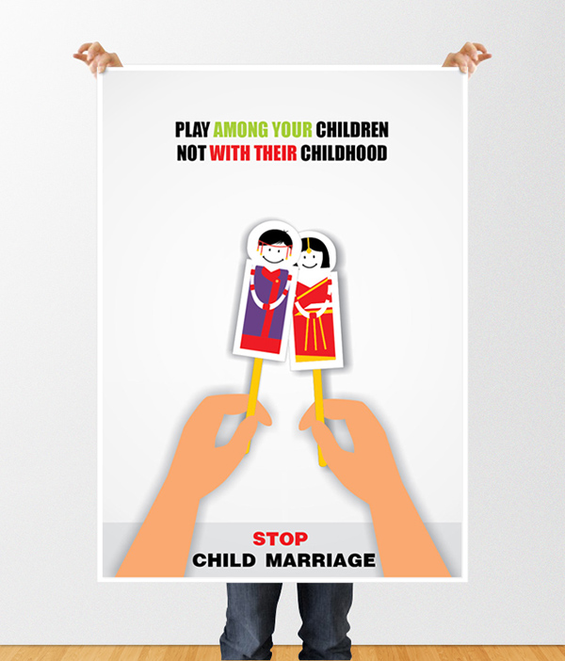

Slide 13
"Be aware, Share Awareness."

